Slide 1

Date
Presenter name
Title

Slide 2



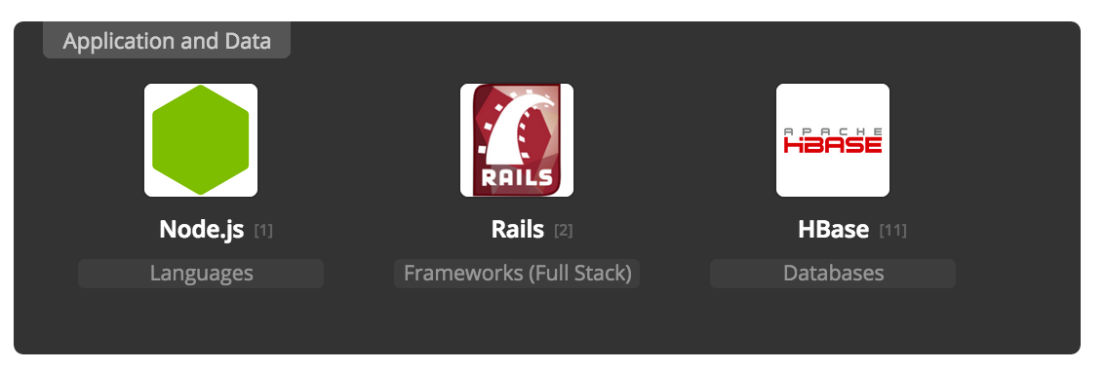
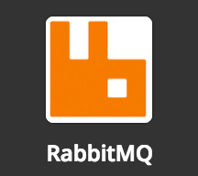
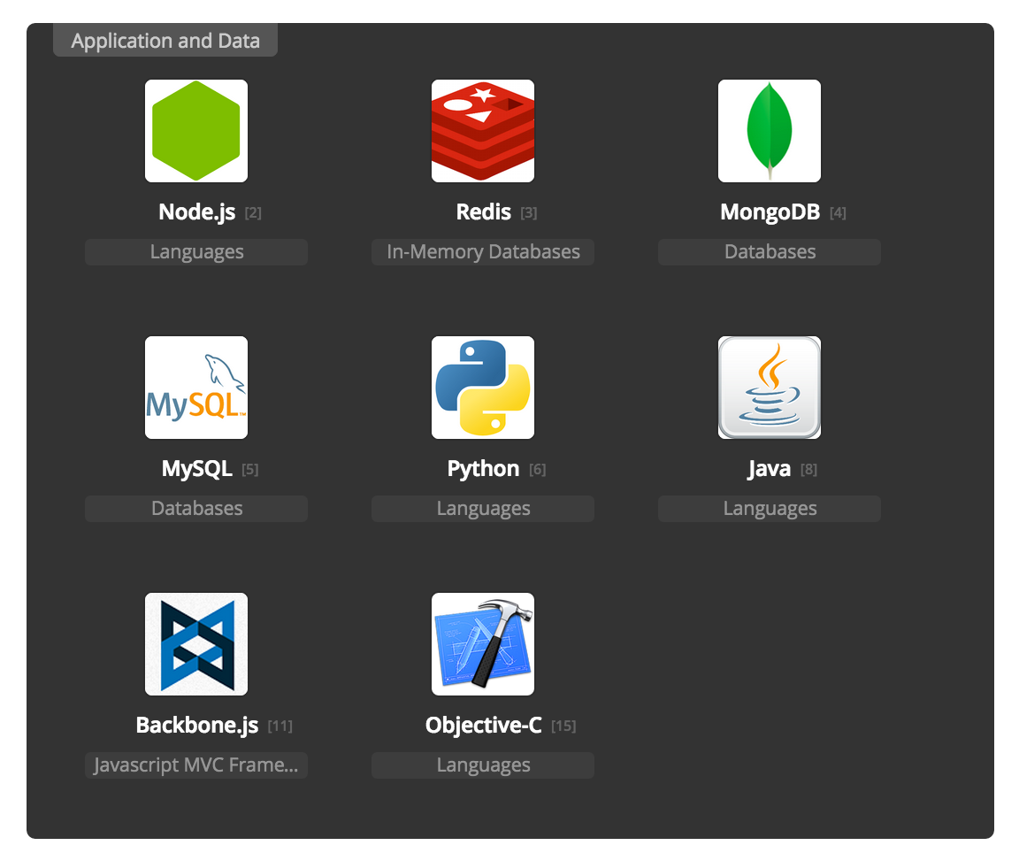
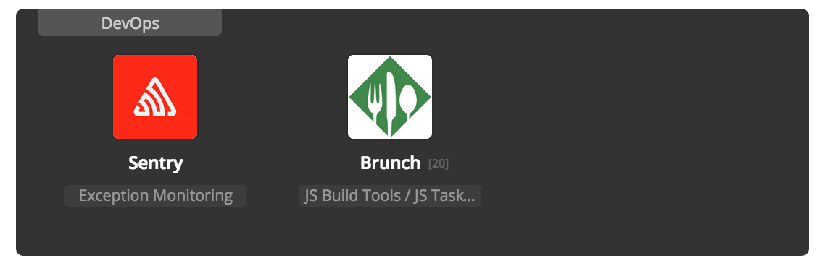


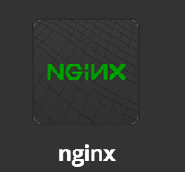
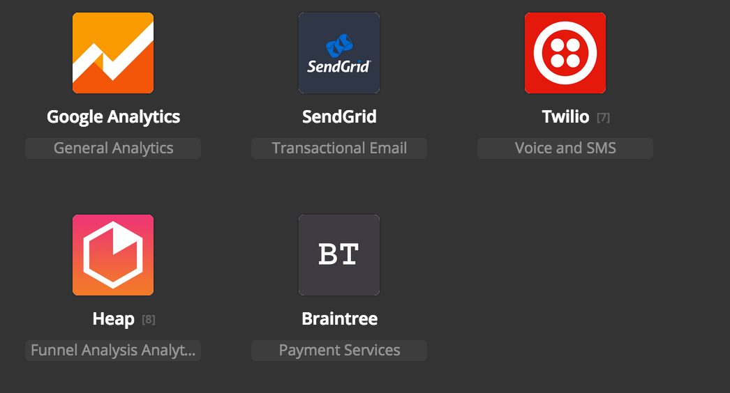

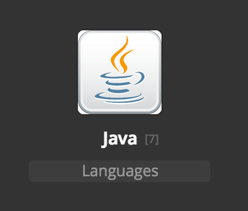
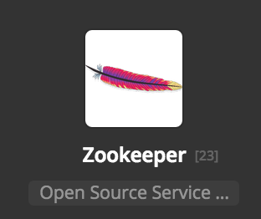

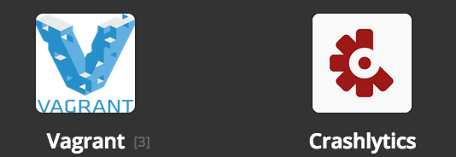


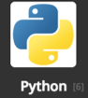
42% of database decision makers admit they struggle to manage the NoSQL solutions deployed in their environments”
Riak
Riak
2
Notes:
Why are we here? We know that your application has a technology stack. We want to work with you to simplify this stack and ensure that your scalability and availability needs are met. That we address your distributed data challenges and simplify your overall technology stack where possible.
Put questions, questions!
Takes lots of technology to take care of it
Invest in creating own applicaton logic to tie them together
Deliver at global scale
Collect everything save everything how am I going to put it to work. Takes a lot of components.
Address the distributed data challenge
Simpler to manage the components

Slide 3

WHO IS BASHO?
Creators of Riak
Distributed, Highly Available, NoSQL Database. 2011 – Riak v1.0
Global Offices Seattle (HQ), Washington DC, London, Tokyo
100+ employees
Customers – 30% of Fortune 50

Slide 4
















































RIAK DEPLOYED WORLDWIDE

Slide 5
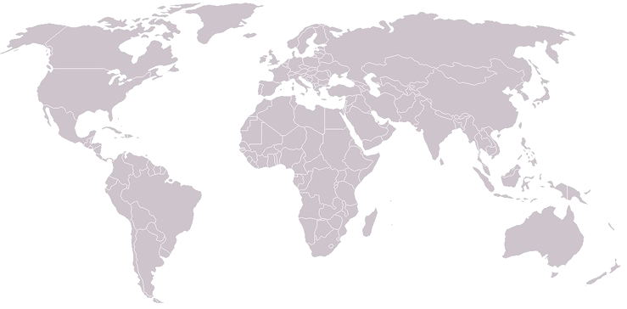







WHY DISTRIBUTED SYSTEMS?
Scale out, up and down predictably
and linearly
Everything works at small scale!
What happens when something goes wrong?
Survive server, network or data
center failures
The customer experience matters?
Data locality enables data operations close to end-users
Notes:
Questions on their distributed work loads

Slide 6


BASHO DEVELOPS
DISTRIBUTED SYSTEMS
Open Source
Distributed NoSQL Database
Commercial
Distributed NoSQL Database

Slide 7


WHAT MAKES RIAK
UNIQUE
Scalability
Low-Latency
High Availability
Fault-Tolerance
Operational Simplicity
Multi-Model
Multi- Datacenter Replication
24x7 Customer Support
Notes:
What makes Riak unique is it
Handles massive data scale in production
Expands easily and scales for geographically disbursed locations reducing latency for end users
Highly available architecture enables any node to service read or write requests
Integration with Riak CS and Apache Solr provides multi-model support from a single platform

Slide 8


We hit peaks well over 250,000 operations per second, all while sustaining sub-millisecond response times and rock solid stability. Despite massive growth, we still do not employ any full-time engineers to work on our Riak cluster. It’s really that easy to use.

Slide 9
RIAK ENTERPRISE
DISTRIBUTED NOSQL DATABASE
Key/Value store
Masterless
Automatic data replication
Multi-Datacenter replication
Robust APIs and client libraries
Fast, robust querying capabilities
Built in flexible data types (CRDTs)
Multi-model platform
MULTI-DATA CENTER REPLICATION
DATA CENTER
#1
DATA CENTER
#2
DATA CENTER
#3
Stores and manages data efficiently and effectively

Slide 10

RIAK SEARCH
Integration with Apache Solr
Integrated Full-text Search Query
Scalability
Simplified Development
Operational Simplicity
Scalable Platform

Slide 11

RIAK CS
Built on Riak Platform
Flexible Object Storage
Massive Scalability
Resiliency
Global Availability
Operational Simplicity

Slide 12












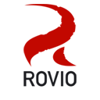





Proven Customer Successes
Broad and visible set of use cases
Public Cloud
Gaming and Betting
Private Cloud
Telecommunications
SaaS / Data Services
Mobile Payments
Digital Media
Social Network
Display Advertising
Consumer Goods
Airlines
Health Care
On-Line Gaming
Weather
Retail and e-Commerce
PaaS Implementation
Internet of things
Supply Chain
Notes:
User Activity
Session Data
Location Data
Content management and distribution
Device data or IOT
Point-of-Sale
Flash Retail
Ad Networks
Product Catalog
Recommendations Engine
Mobile Payments
Health Monitoring
Health Records
Supply Chain Visibility

Slide 13
BASHO PROFESSIONAL SERVICES
Expertise When You Need It
On-Site Training
Riak Developer Training
Riak Operations Training
Implementation
Riak Implementation
Riak CS Implementation
Assessment / Analysis
System Assessment
Performance Assessment
Use Case/Data Access Analysis
Custom Services
Example: Data Modeling
Example: Data Migration
Basho Confidential

Slide 14
RIAK FLEXIBLE PLATFORM
GROWS AS YOU GROW
SIMPLE
POWERFUL
SCALABLE
Easily Add Capacity
Fault Tolerant
10’s of Millions of Simultaneous Users
Multi-model KV / Object Storage / Search
Commodity HW
Billions of Data Points
Key/Value
Low Latency
100’s of Nodes

Slide 15






RIAK CUSTOMERS
MEDIA
HEALTHCARE
INTERNET OF THINGS (IoT)
A massive data explosion is at the center of our growth strategy. Riak is a critical component of our new IT platform
Using Riak to insure high data availability helps avoid health risks, and in the worst case, patient death
Riak is used to manage thousands of users and millions of meters that create billions of data points
TELECOMMUNICATIONS
ECOMMERCE
GAMING
Riak provides a lot of operational simplicity for us. It just works.
Riak’s architecture played a key role in transforming our eCommerce platform
To enable rapid iteration at scale, Riot moved to Riak to support millions of concurrent players at any moment

Slide 16

15

